Slide 1

FUEL CONSUMPTION RATINGS
BDAT 1011- Data Analytics Project
Group - 13

Slide 2
Project Summary
There are three main categories of fossil fuels. Coal is mined and powers one-third of the world's electricity. Crude oil is extracted from the earth and refined to create the various oils we use as fuel. Natural gas, which is primarily methane and is found near oil resources, is what gave rise to the contentious fracking technique.

Slide 3


Team
Sesha sai Gopal
(Team Lead/ Developer)
Murali Krishna Penikalapati
(Business analyst/ Developer)

Slide 4
Contents
Research
Data Cleaning
EDA Python
Power BI Dashboard
Documentation

Slide 5
Research Questions
Top 5 countries in fuel production over a decade.
Top 5 countries in fuel consumption over a decade.
Track Canada’s trend in fuel production and consumption.
Major countries that purchase the fuel.
Global fuel production and consumption trend since a decade.

Slide 6
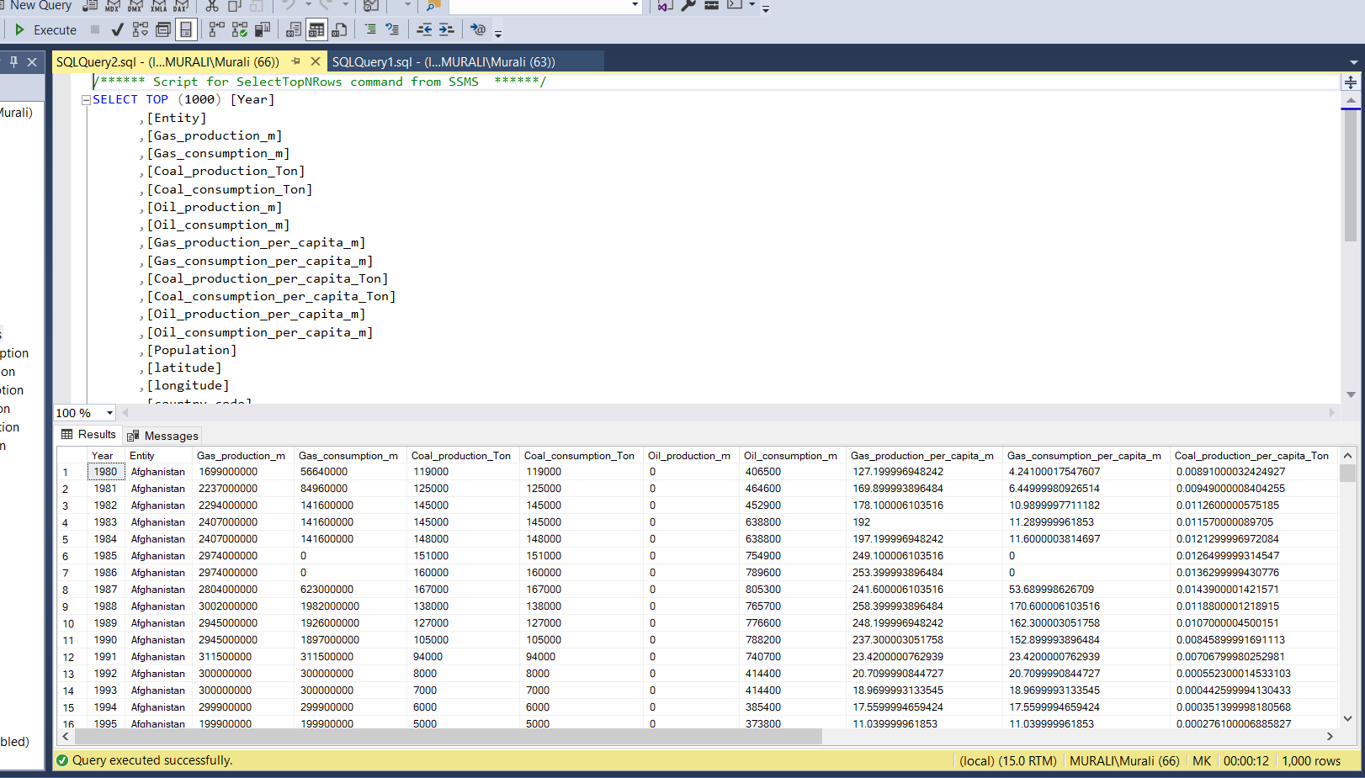
Data Cleaning
Collected datasets was loaded into SSMS and data cleaning was done using SQL queries for further analysis.
We created the views for research question from the dataset as presented in figures.
Final dataset was prepared by merging the two datasets, after cleaning (Fuel data & Geo Coordinates Data).

Slide 7
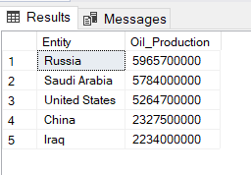
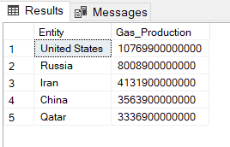
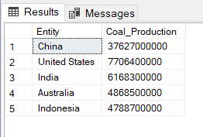
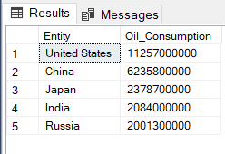
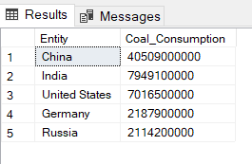
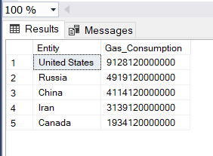
Fuel Production and consumption SQL views

Slide 8
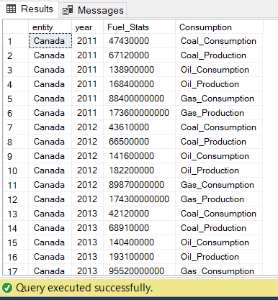
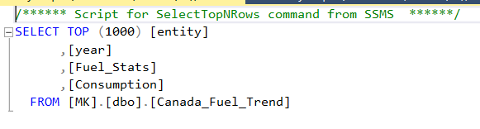
Canada Fuel trend made with SQL Queary
SQL Query

Slide 9
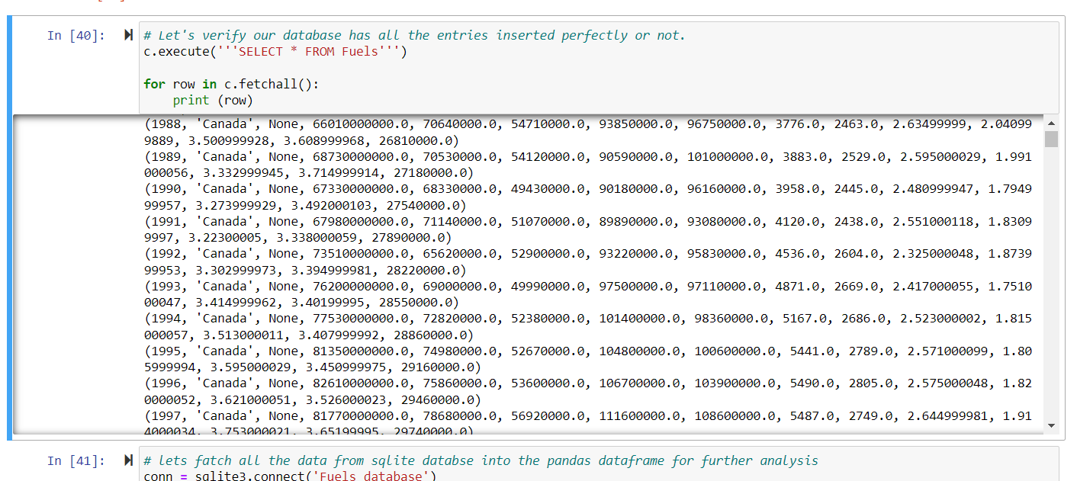
EDA Python
Cleaned data and fetching data to create views

Slide 10
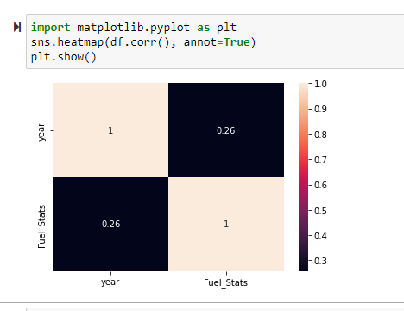
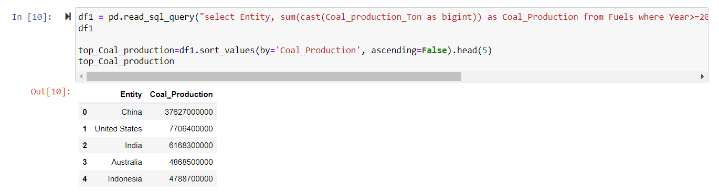
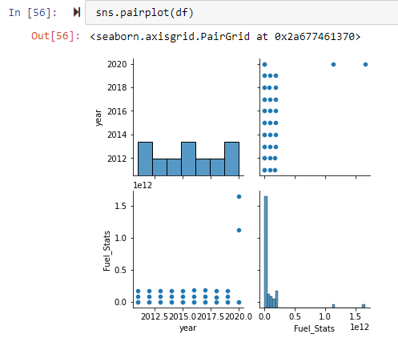
EDA Python
Cleaned dataset was further used to perform EDA analysis using Python.
As part of the process, prepared ython code to perform transformations and created views.

Slide 11
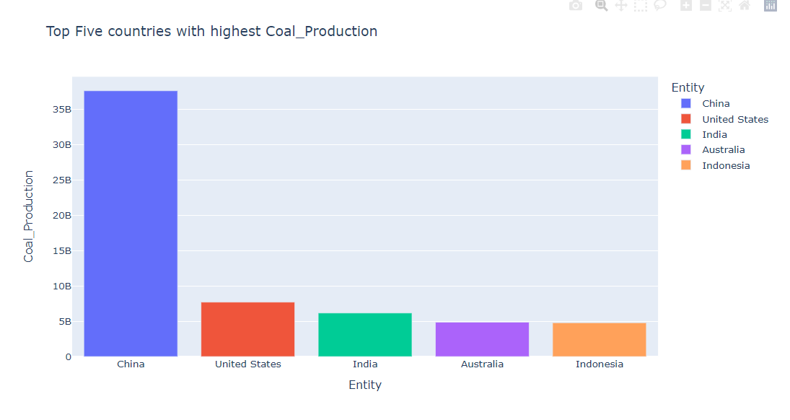
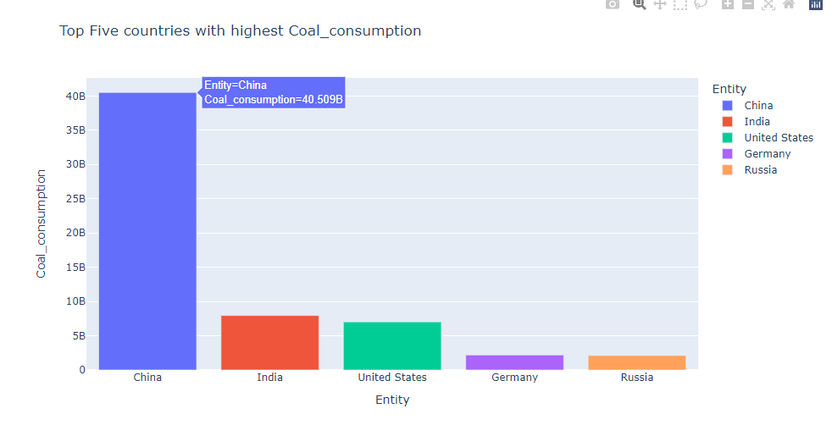
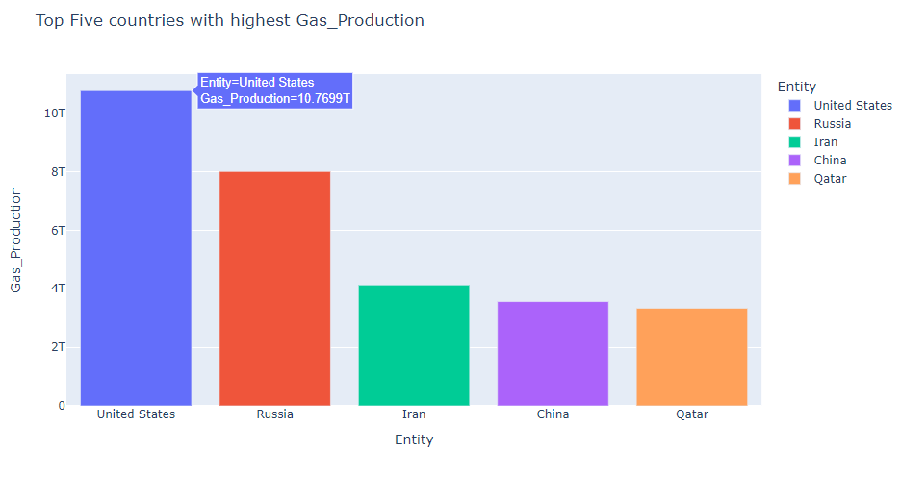
EDA Python

Slide 12
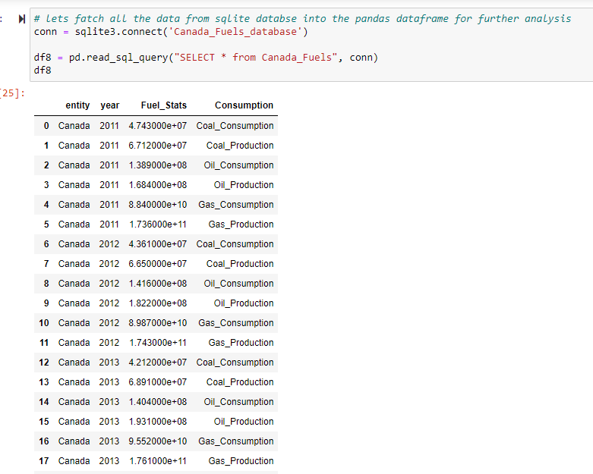
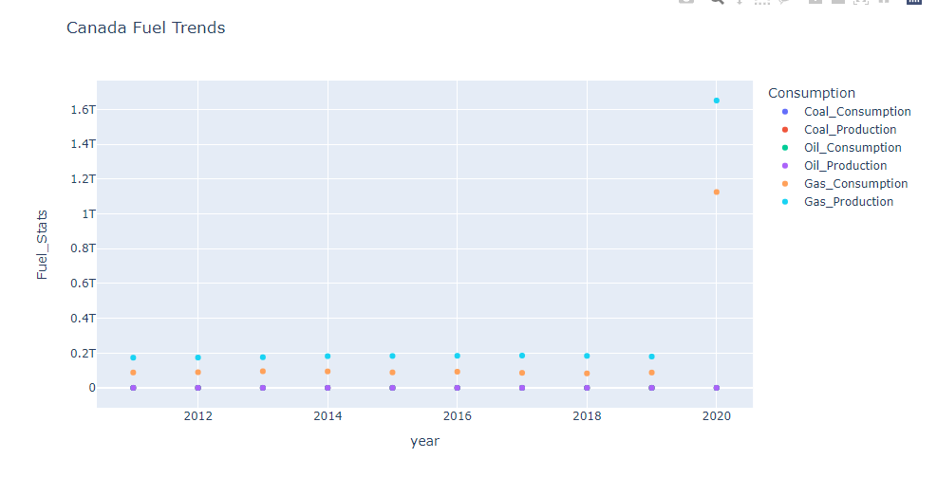
EDA Python

Slide 13
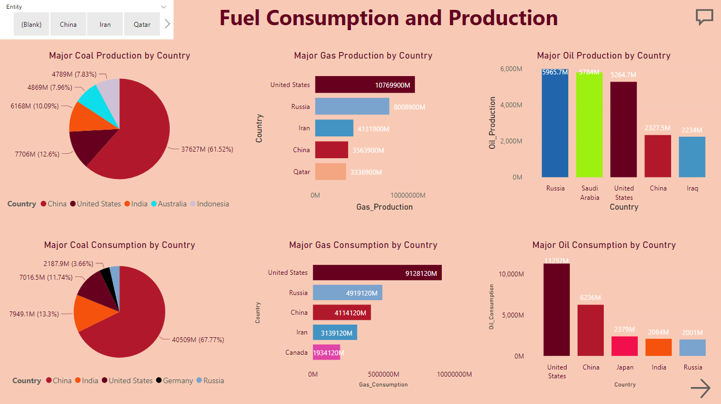
Power BI Dashboard
An interactive dashboard is created using Power BI.
Dashboard contains the visualizations answering all our research questions along with resource links and references.

Slide 14
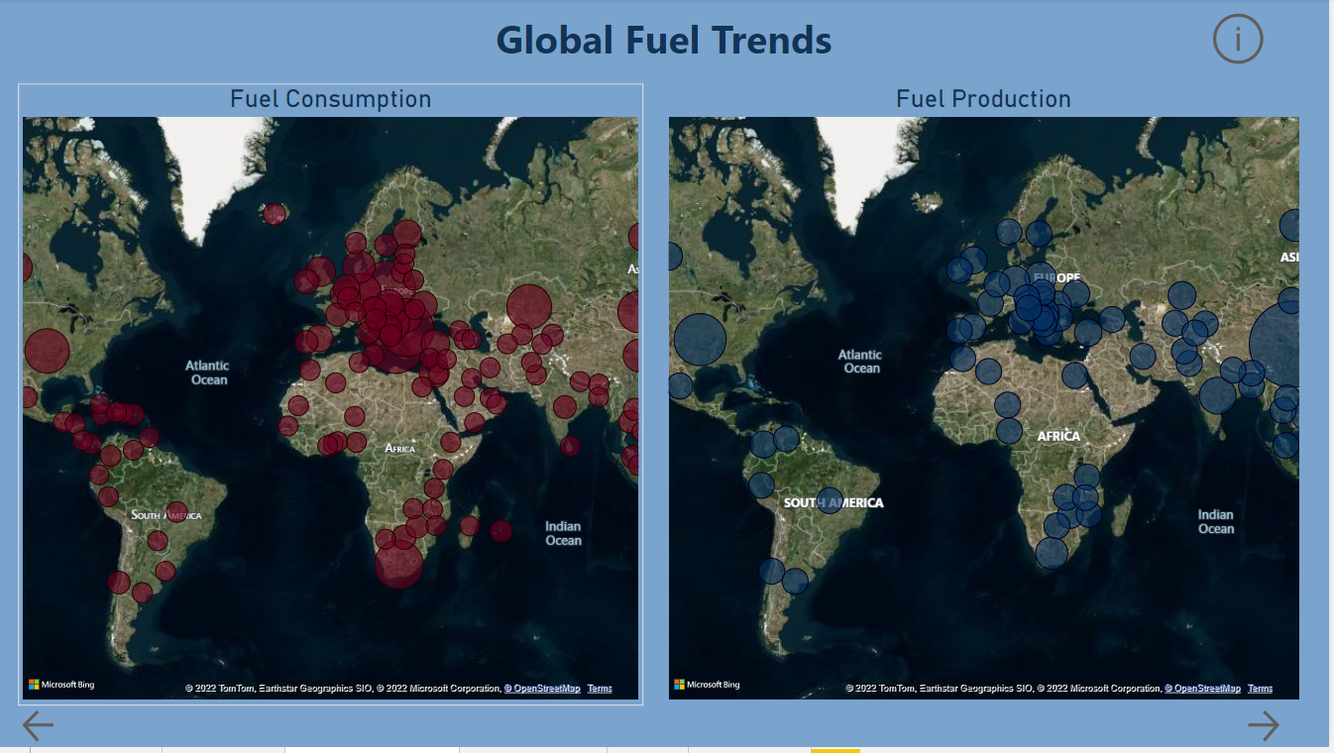
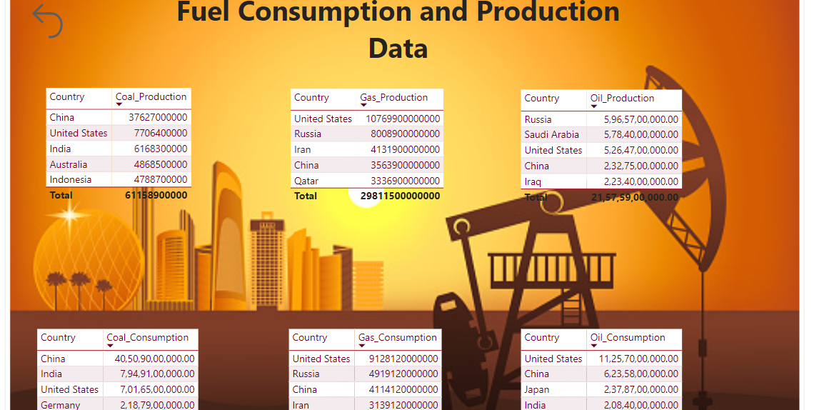
Power BI Dashboard
An interactive dashboard is created using Power BI.
Dashboard contains the visualizations answering all our research questions along with resource links and references.

Slide 15
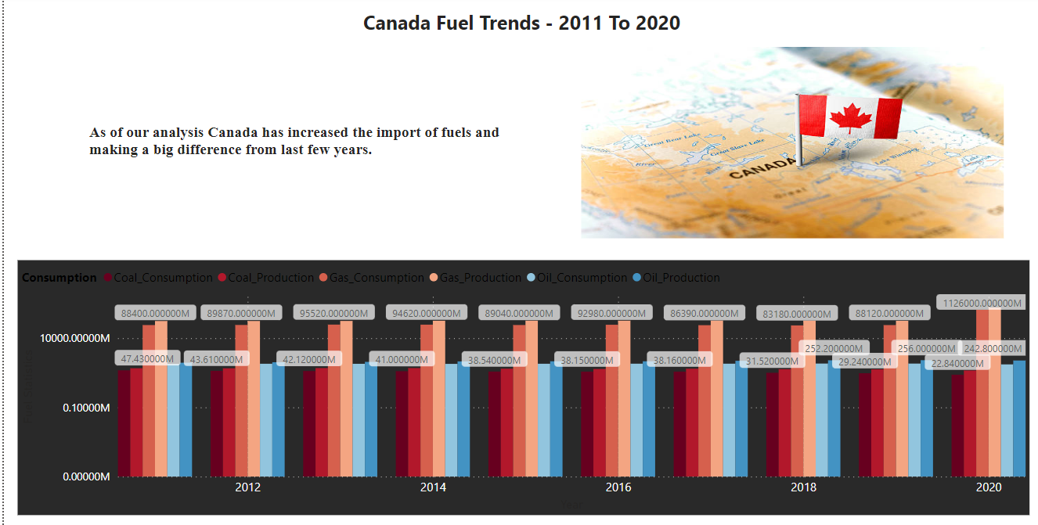
Power BI Dashboard

Slide 16
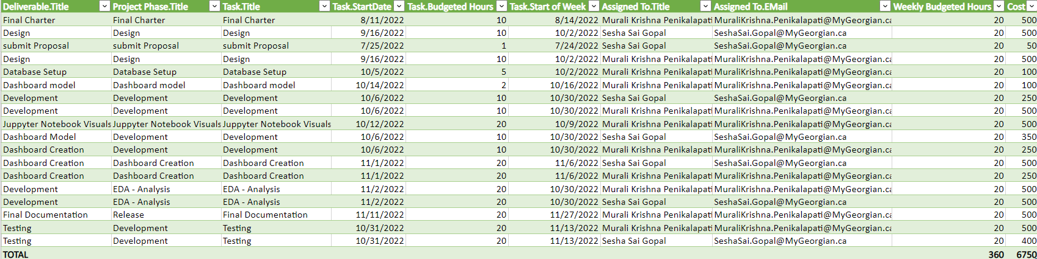
Budget

Slide 17
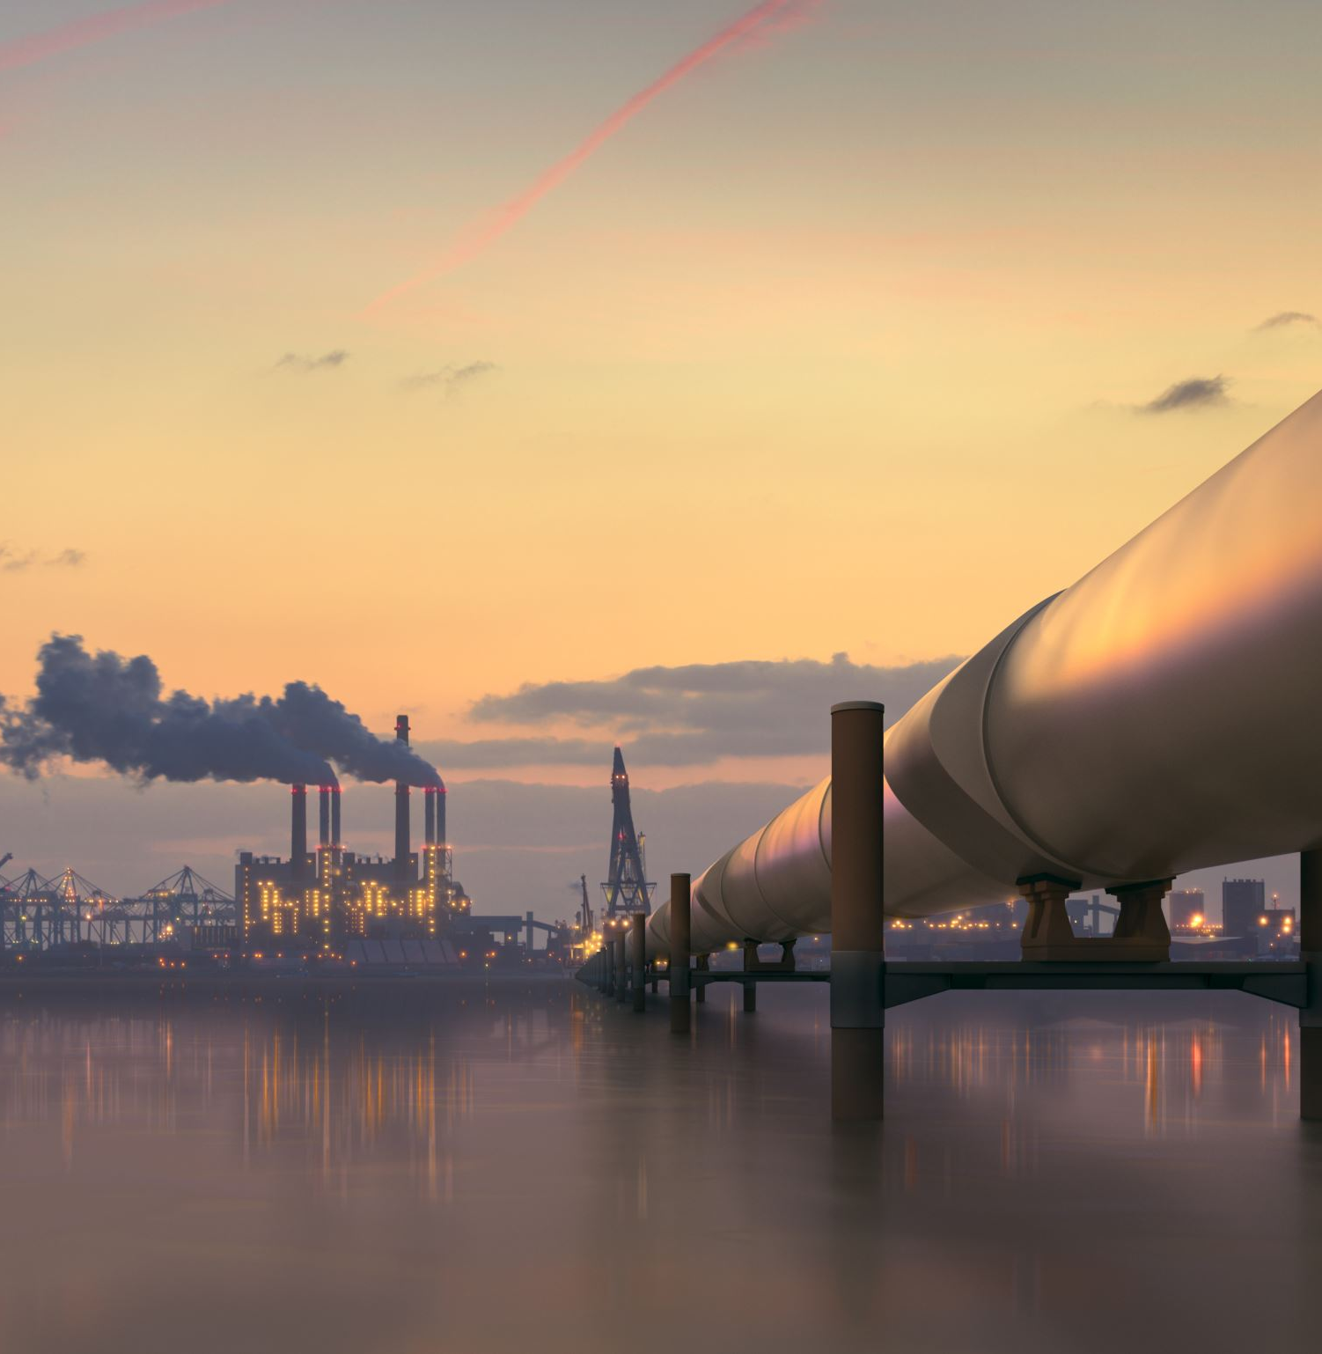
Conclusion
Based on are analysis with the Global fuel data, we can summaries that the fuel consumption and production is rapidly increasing year by year. This might lead to fuel crises in the future.
This can be avoided by picking up the alternative methods like switching to solar based power generation and using electric or mostly hybrid vehicles.

Slide 18
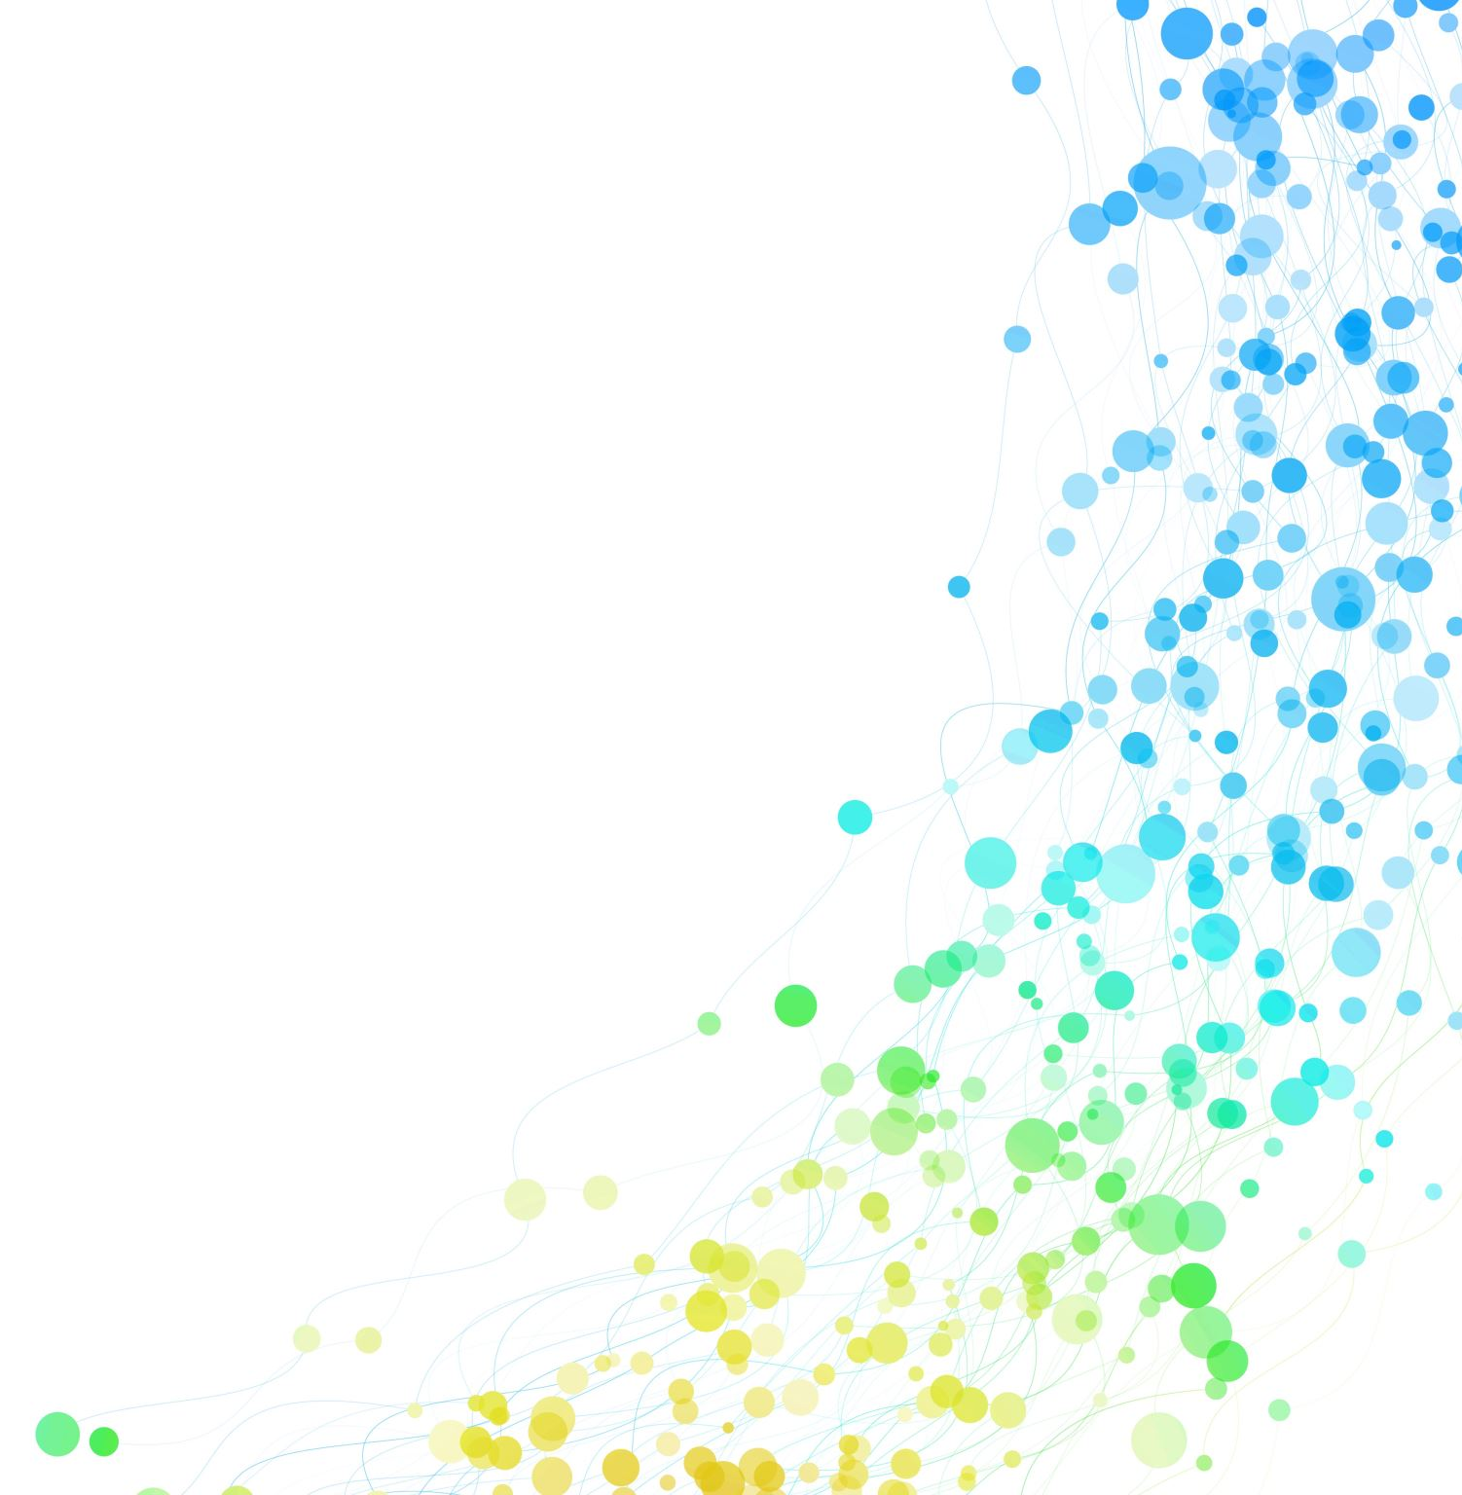
Resources
Data Source: https://www.kaggle.com/datasets/shawkatsujon/worldwide-fuel-production-and-consumption
Share Point: https://georgiancollege.sharepoint.com/sites/Test651
Canada Fuel Trend: https://www.iea.org/articles/fuel-economy-in-canada
Global Fuel Stats: https://ourworldindata.org/fossil-fuels

Slide 19
Thankyou..

